Slide 1
BFX AT-100 Ethernet fail FA report
Prepare by: PE – JUSTIN
Date: 2025/01/14

Slide 2
FA TEAM
Fii | ALT OTT
Team Leader: PE Leader: Jack Han TE Leader: Mark QA: Toney Tu Team Members: TE: Allan ME: Wen-tai PE: Michael Ruan/ Justin QA: Ken/ Rachel PM: Roisy | Team Leader: QA: SH Son Team Members:

Slide 3
Problem Description
Issue Description (5W1H)
When | 2025-Jan-10
Who | SH Son
Where | ALT customer side
What | ALT customer complain 1pc DOA T99X171.00 Ethernet fail
Why | TBD
How many | 1pc / 1600pcs ~ 0.06%, S/N range: 2149688001202404449199
On 10-Jan, 2025, T99X171.00 model, ALT customer complain 1pcs DOA issue: Ethernet fail
S/N range : 2149688001202404449199
Defect rate: 1pc/1600pcs
Fail symptom: Ethernet function check => NG

Slide 4
Confirm Fail Symptom
Symptom:
ALT customer feedback Ethernet doesn’t work
ALT initial review
Visual check -> No found abnormal.
Update check -> No found abnormal
+ By USB and By USB burning tools
Suggestion:
Product boot up normal but can’t connect with Ethernet➔ Suspect Ethernet block have issue (NG board can’t connect to internet )

Slide 5
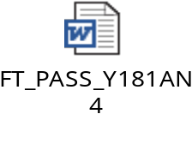
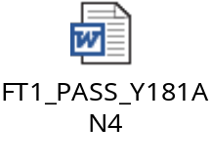
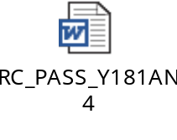
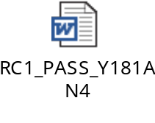
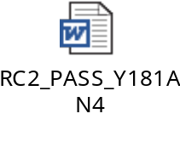
Production History Data Checking
T Level data (SMT)
SN | Test Station
Y181AN4 | SMTLOADING | TURNPCB | SPI2 | AOI_2 | INSP | PCB_STOCKIN
 | 11/2/2024 14:41 | 11/3/2024 13:09 | 11/4/2024 14:30 | 11/4/2024 14:48 | 11/4/2024 14:58 | 11/4/2024 18:23
Dot Level data (FATP )
S/N range | Test Station
2149688001202404449199 | UK | FT | FT1 | RC | RC1 | RC2
 | 11/12/2024 13:43 | 11/12/2024 13:49 | 11/12/2024 13:57 | 11/12/2024 14:03 | 11/12/2024 14:15 | 11/13/2024 13:29
Test logs | UK test haven’t logs test
Summary:
- This unit has PASSED normally SMT and FATP.
- Shipping date: 2024/11/18

Slide 6
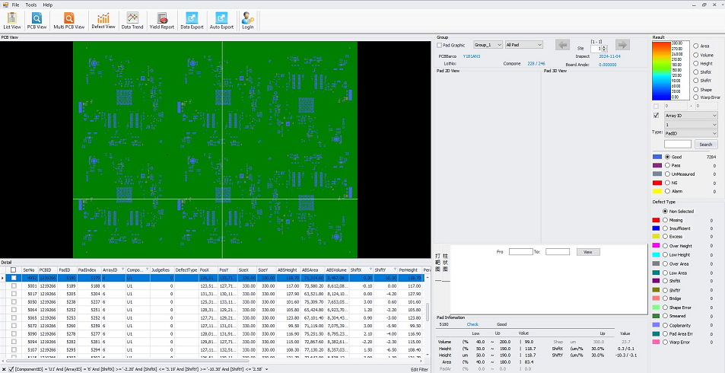
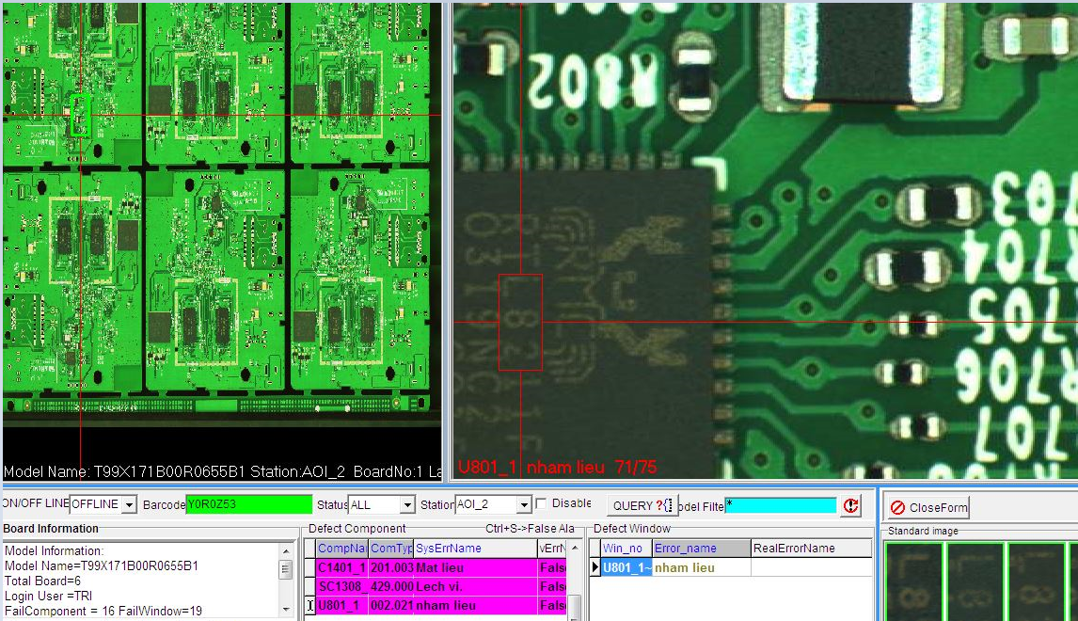
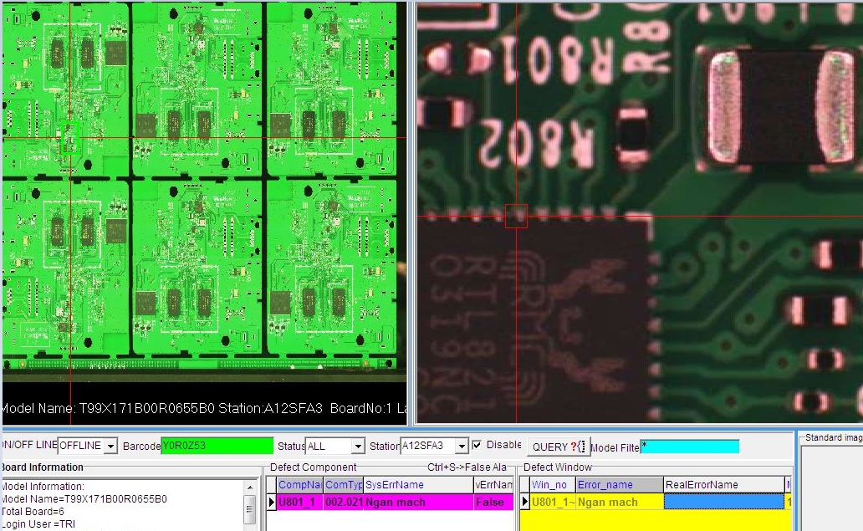
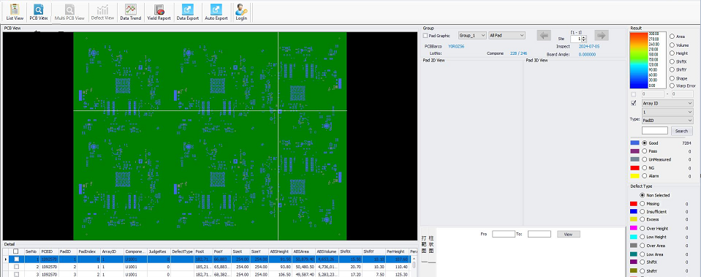
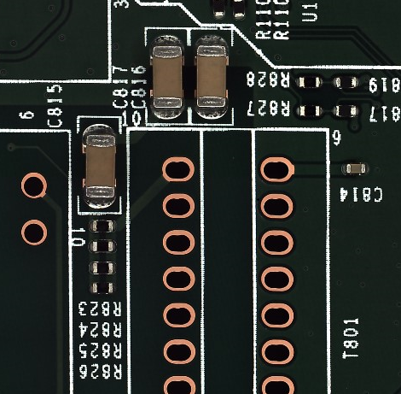
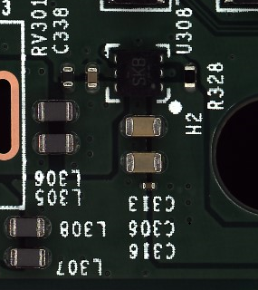
SPI / AOI History Data checking
Side | SPI | Pre-AOI | Post-AOI | Remark
BOT |  |  |  | History data not found issue at SPI & pre-AOI and Post AOI station
TOP |  |  |  | History data not found issue at SPI & pre-AOI and Post AOI station
Result | Good | Normal | Normal
Summary: The SPI & Pre-AOI and Post-AOI not found issue

Slide 7
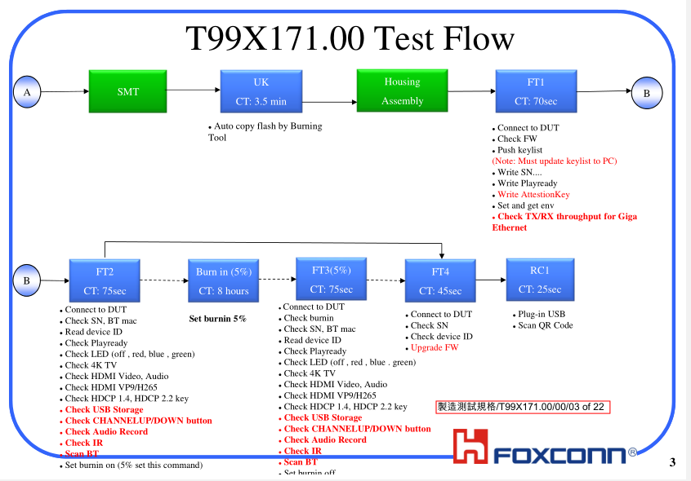
No Boot FATP Test Coverage
FATP process:
Summary :
Ethernet fail then can’t test at FT, FT1, FT3, FT4, RC station ➔ Ethernet fail can cover 100% at FATP

Slide 8
Summary
Summary:
- This unit has PASSED normally SMT and FATP.
- Shipping date: 2024/11/18
- The SPI & Pre-AOI and Post-AOI history not found issue
- Ethernet fail can cover 100% at FATP
Action:
- Fii need to get NG board on hand to analysis to find out root cause. Therefore, may can we suggest that ALT send Defective samples back to Vietnam for us to analyze further.

